Slide 1


P.K.M Educational Trust®
R.R. INSTITUTE OF TECHNOLOGY
(Affiliated to VTU, Belagavi | Approved by AICTE, New Delhi & Government of Karnataka) Accredited by NAAC with B+
Department of Computer Science and Engineering
Deepfake Creation and Detection Using Cycle GANs
Presented By :
Charan K 1RI16CS013
Naveed Ahmed 1RI17CS027
Nikith Kumar N 1RI17CS028
Shankar R A 1RI17CS043
Under the guidance of
Prof. SHRUTHI S
Asst Prof, Dept of CSE, RRIT

Slide 2
TABLE OF CONTENT
1. Abstract
2. Introduction
About Domain
Objectives
Problem Identified
ystemExisting S
Our Proposed System
3. Literature Survey
4. System Requirements
Functional Requirements
Non- Functional Requirements
Hardware Requirements
Software Requirements
5. System Design
System Architecture
Data Flow Diagram
6. Expected Outcomes
7. Gantt chart

Slide 3
01
ABSTRACT
A Deepfake is one of those deep learning-powered applications that have recently emerged. Deepfake algorithms can generate fake images and videos that can not be distinguished by humans from real ones.
Deepfake creation and detection have so far been dominated by “artifact-driven ” methods and the detection performance significantly degrades when either the type of image artifacts is unknown or the artifacts are simply too hard to find.
The most common form of deepfakes involves the generation and manipulation of human imagery.

Slide 4
02
INTRODUCTION
Deepfake is a technique that can superimpose face images of a target person to a video of a source person to create a video of the target person doing or saying things the source person does. The underlying mechanism for deepfake creation is deep learning models such as autoencoders and generative adversarial networks, which have been applied widely in the computer vision domain.
Deepfake methods normally require a large amount of image and video data to train models to create photo-realistic images and videos.
To overcome such a situation, Deepfake detection is very important. So, a deep learning-based method that can effectively distinguish AI-generated fake videos (Deepfake Videos) from real videos.

Slide 5
ABOUT
DOMAIN
Deep learning is a class of machine learning algorithms that uses multiple layers to progressively extract higher-level features from the raw input. For example, in image processing, lower layers may identify edges, while higher layers may identify the concepts relevant to a human such as digits or letters or faces.
The main machine learning methods used to create deepfakes are based on deep learning and involve training generative neural network architectures, such as autoencoders or generative adversarial networks (GANs).
Deepfakes are synthetic media in which a person in an existing image or video is replaced with someone else's likeness. While the act of faking content is not new, deepfakes leverage powerful techniques from machine learning and artificial intelligence to manipulate or generate visual and audio content with a high potential to deceive.

Slide 6
OBJECTIVES
The aim of this project is to provide the reader with a deeper understanding of the creation and detection of deepfakes, the current trends and advances in this field, the weaknesses of current defense solutions, and the areas that require further research and attention.
One of the important objectives is to evaluate its performance and acceptability in terms of security, user friendliness, accuracy and reliability.
Explore the possibility of detecting fake images/videos for any social media platforms. If we can successfully detect fake images/videos from social media platforms, it would significantly reduce the user effort to identify fake images/videos.

Slide 7
EXISTING
SYSTEM
There are many tools available for creating the deepfake, but for deepfake detection there is hardly any tool available. Our approach for detecting the deepfake will be a great contribution in avoiding the percolation of the deepfake over the world wide web.
Since most of the deepfakes are created via adversarial training (GANs), the creator algorithm’s ability to evade AI-based detection methods will improve as they are introduced to new detection systems.
Recently, Facebook Deepfake Detection Challenge (DFDC) Results: The best models got 65% accuracy on real-world data. The results reinforce the difficulty of deepfake detection and emphasize the limitations of AI models to mitigate the synthetic media threat.

Slide 8
OUR
PROPOSED SYSTEM
Our approach for creating and detecting the deepfake will be a great contribution in avoiding the percolation of the deepfake over the world wide web. The project can be scaled up from developing a web based platform to a browser plugin for automatic deepfake detections.
Even big applications like WhatsApp, Facebook can integrate this project with their application for easy pre-detection of deepfake before sending it to another user.
One of the important objectives is to evaluate its performance and acceptability in terms of security, user-friendliness, accuracy and reliability. Our method is focusing on detecting all types of deepfake like replacement deepfake , retrenchment deepfake and interpersonal deepfake.

Slide 9
03
LITERATURE
SURVEY

Slide 10
Year & Author | Title | Problem Identified | Method | Outcomes
2019 Yuezun Li, Siwei Lyu | Exposing Deepfake Videos by Detecting Face Warping Artifacts | Detect artifacts by comparing the generated face areas and their surrounding regions with a dedicated Convolutional Neural Network model. | Convolutional Neural Network | Generate images of limited resolutions, which are then needed to be further transformed to match the faces to be replaced in the source video.
2018 Ming-Ching Chang, Siwei Lyu | Exposing AI Generated Fake Face Videos by Detecting Eye Blinking | Detection of eye blinking in the videos, which is a physiological signal that is not well presented in the synthesized fake videos. | Deep Neural Network based software Deepfake. | The method is evaluated over benchmarks of eye-blinking detection datasets and shows promising performance on detecting videos generated

Slide 11
Year & Author | Title | Problem Identified | Method | Outcomes
2021 Dongze Li, Wei Wang | Exploring Adversarial Fake Images on Face Manifold | Detection systems based not only on features at image level, but also at temporal level, along the frames of the video | Combination of CNNs and RNNs | Proposed in a temporal-aware pipeline to automatically detect fake videos.
2020 Ruben Tolosana, Ruben Vera-Rodriguez | DeepFakes and Beyond: A Survey of Face Manipulation and Fake Detection | DeepFakes are created by splicing synthesised face regions into the original image | Support Vector Machine (SVM) using UADFV database | The differences between head poses estimated using a full set of facial landmarks and those in the central face regions to differentiate DeepFakes from real videos.

Slide 12
Year & Author | Title | Problem Identified | Method | Outcomes
2019 Ming Liu, Yukang Ding, Min Xia | STGAN: A Unified Selective Transfer Network for Arbitrary Image Attribute Editing | The challenge of expression swap manipulation, also known as face re-enactment, consists of modifying the facial expression of the source person. | Face2Face and Neural Textures, | Replaces the facial expression of one person in a video with the facial expression of another person.
2020 Daniel Mas Montserrat, Hanxiang Hao | Deepfakes Detection with Automatic Face Weighting | The bottleneck layer in the encoder-decoder usually provides blurry and low quality manipulation results | Encoder-Decoder or General Adversarial Network (GAN) | Selective transfer units with an encoder-decoder for simultaneously improving the attribute manipulation ability and the image quality.

Slide 13
04
SYSTEM
REQUIREMENTS

Slide 14
FUNCTIONAL
REQUIREMENTS
Deepfake Creation :
Deepfakes have become popular due to the quality of tampered videos and also the easy-to-use ability of their applications to a wide range of users with various computer skills from professional to novice.
One variant of the deep networks with that capability is deep autoencoders, which have been widely applied for dimensionality reduction and image compression
The first attempt of deepfake creation was FakeApp, developed by a Reddit user using autoencoder-decoder pairing structure.
Deepfake Detection :
Deepfakes are increasingly detrimental to privacy, society security and democracy.
Test results show that the popular face recognition systems based on VGG and Facenet are unable to detect deepfakes effectively. Other methods such as lip-syncing approaches and image quality metrics with support vector machines (SVM) produce very high error rates

Slide 15
NON-FUNCTIONAL
REQUIREMENTS
Accessibility :
The extent to which the software system can be used by people with the widest range of capabilities to achieve a specified goal in a specified context of use.
Efficiency :
The extent to which the software system handles capacity, throughput, and response time.
Interoperability :
The extent to which the software system is able to couple or facilitate the interface with other systems.

Slide 16
HARDWARE & SOFTWARE REQUIREMENTS
SOFTWARE REQUIREMENTS
Programming Language : Python 3
Programming Framework : PyTorch
Web Framework : Django (hosting)
IDE : Google Colaboratory, VS Code
Operating System : Windows or Linux
HARDWARE REQUIREMENTS
GPU : Cuda Cores supported GPU
Processor : Core i5 /AMD Ryzen series (3.9GHz)
Webcam / Camera
RAM: 4GB or above
Miscellaneous : USB interface, Power Adapter

Slide 17
05
SYSTEM
DESIGN

Slide 18
SYSTEM DESIGN
For Deepfake Creation, the user can upload the image from the user's system directory and then select the video for deepfake ie; the target video then the model will start training and the reconstructed video will result from the user source image.
For Deepfake Detection, the user uploads any video from the user's system directory, then the model starts pre-processing the video and splits it into frames, then loads it into a data loader. Then ResNext CNN will classify the image whether it's original or fake, then move it to LSTM, then output of the model is going to be whether the video is deepfake or a real video

Slide 19
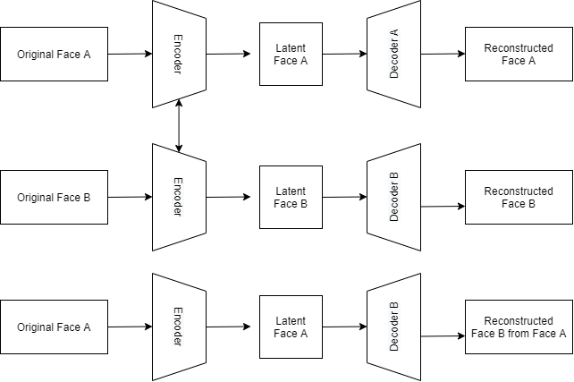
SYSTEM
ARCHITECTURE
System Architecture for Deepfake Creation:
Training Phase: There are two phases involved in developing deepfakes. First is the training phase, which deals with the initial image manipulation.
Test Phase: Then, the test phase begins, which involves the warped image with another image that produces the specific result the creator is looking for.

Slide 20
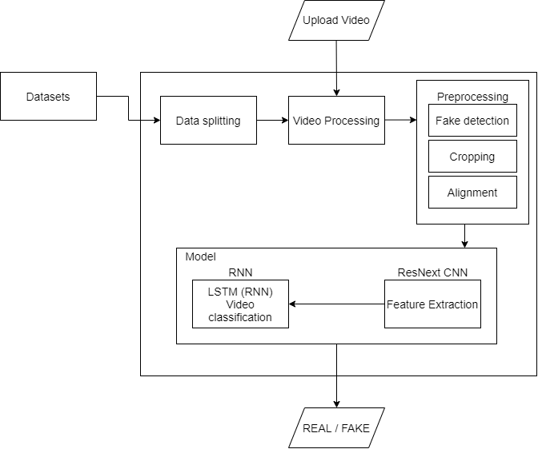
System Architecture for Deepfake Detection:
Procedure to create and detect model:
Dataset
Preprocessing
Model
ResNext CNN for Feature Extraction
LSTM for Sequence Processing
Predict
SYSTEM
ARCHITECTURE

Slide 21
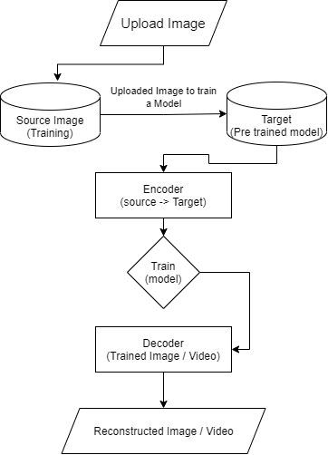
DATAFLOW
DIAGRAM
Data Flow Diagram for Deepfake Creation:
The user must first upload the image from their system directory and select the video of the target person, then after some time the model will train the source image from the encoder to the targeted person decoder, resulting in the reconstructed video from the source image.

Slide 22
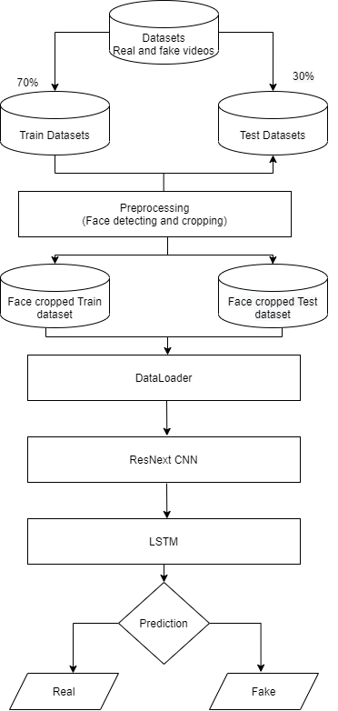
DATAFLOW
DIAGRAM
Data Flow Diagram for Deepfake Detection :
The output of the model is going to be whether the video is deepfake or a real video along with the confidence of the model.

Slide 23
06
EXPECTED
OUTCOMES

Slide 24
EXPECTED OUTCOMES
The project is designed with a neural network-based approach to classifying the video as deep fake or real. The proposed method is inspired by the way in which deep fakes are created by GANs with the help of Autoencoders.
Our method is used to detect frame level using ResNext CNN and to classify video using RNN along with LSTM. The proposed method is capable of detecting a video as a deep fake or real based on the parameters.
A web based platform for the user to upload the video and classify it as fake or real as well as the user can create their own deepfake image or video. The immediate goal of this project is to focus on detecting all types of deepfake like replacements deepfake, retrenchment deepfake and interpersonal deepfake.

Slide 25
07
GANTT
CHART

Slide 26
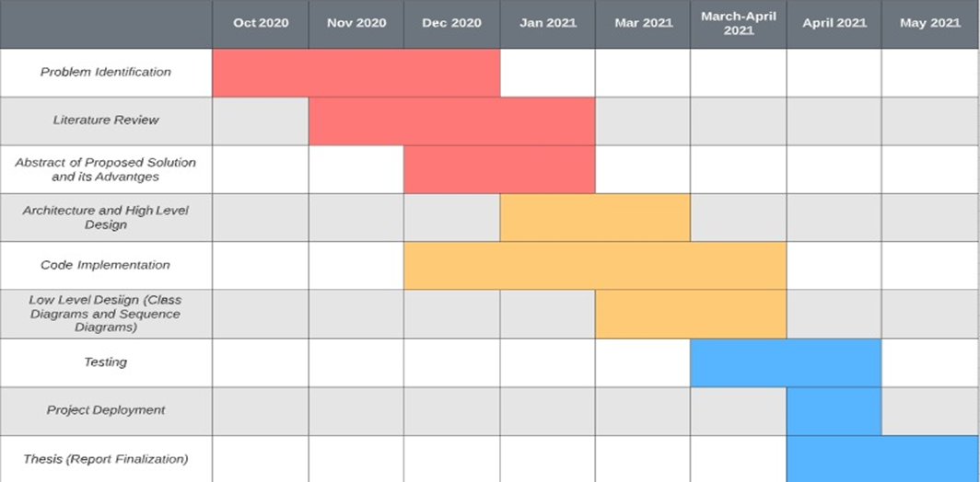

Slide 27
REFERENCES
IEEE PAPERS & LINKS:
Deep Learning for Deepfakes Creation and Detection: A Survey
A Convolutional LSTM based Residual Network for Deepfake Video Detection
The Creation and Detection of Deepfakes: A Survey
Generative Adversarial Networks
Github: deepfake / face swap

Slide 28
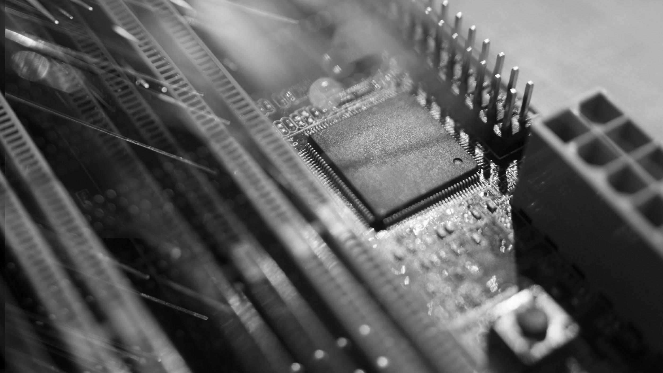
THANK YOU
GitHub: https://github.com/Team-The-Squad-X/Project-MagniZent/
contactme@gmail.com
+91 8310873738

